Slide 1


BLOCKCHAIN
SE SSI O N S 01
Demystifying blockchain and cryptocurrency - Crypto 101
Prof. Manoel Gadi

Slide 2

Blockchain, How it works

Slide 3
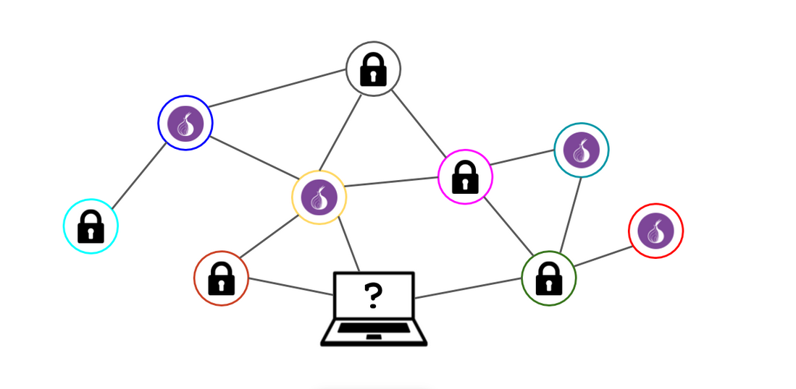
Blockchain and its potential
Invented in 1991 to emulate a notary, it was not used until Satoshi Nakamoto, in 2009, created Bitcoin.
It was introduced by Bitcoin, and given its potential across industries and sectors.
Blockchain is one of the emerging technologies in the world today.
It has to do with the idea of a decentralised network as opposed to the conventional centralised mechanism.

Slide 4
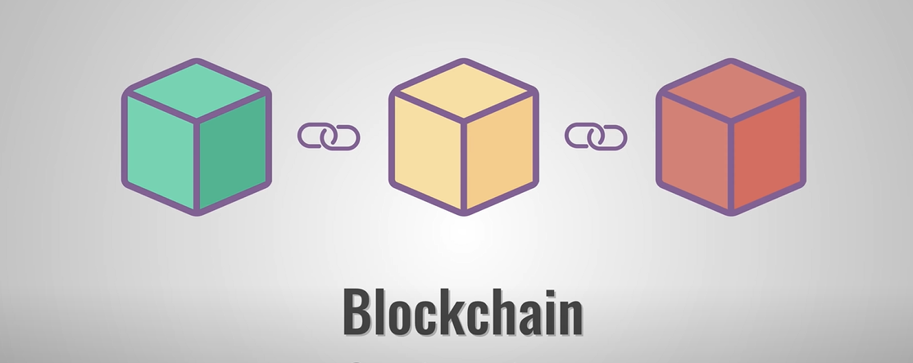
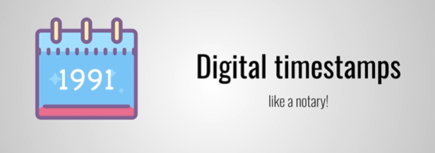

What is a blockchain?
Invented in 1991 to emulate a notary, unused until Satoshi Nakamoto in 2009 created Bitcoin.

Slide 5
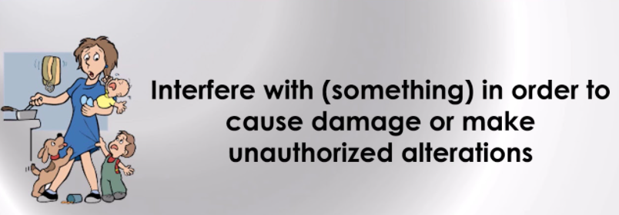
Secure
Impossible to backdate or tamper.
Tamper

Slide 6

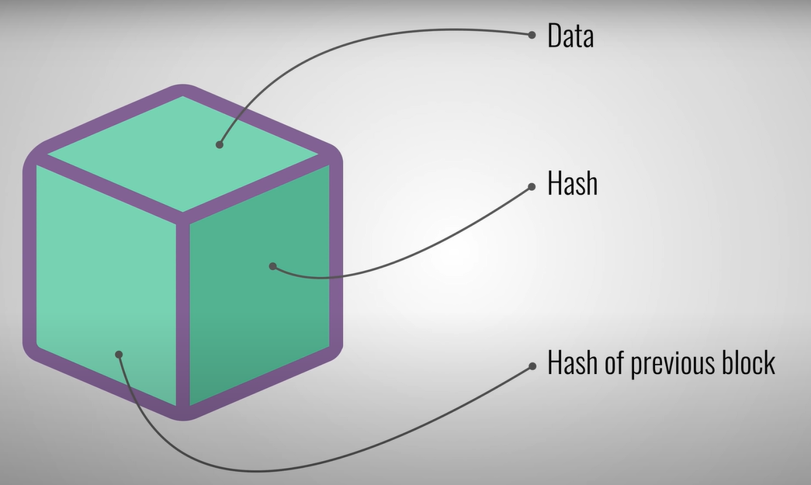
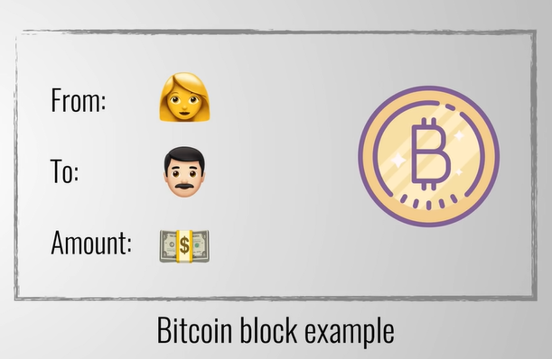
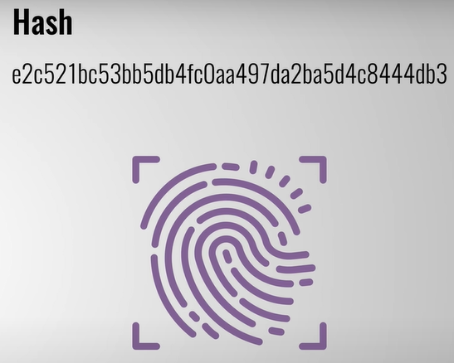
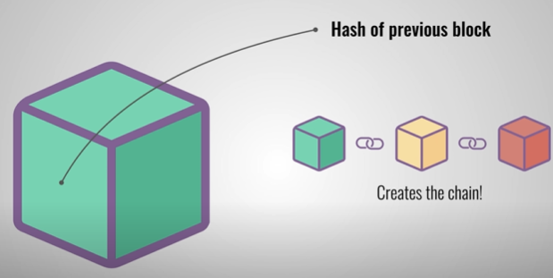
The block
BitCoin data:
sender
receiver and
ammount
Hash is unique and is
calculated based on all information in the block.
Including the hash of
the previous block.

Slide 7
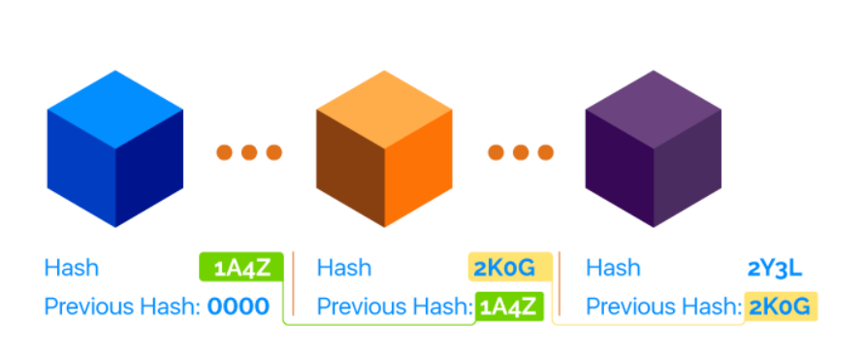
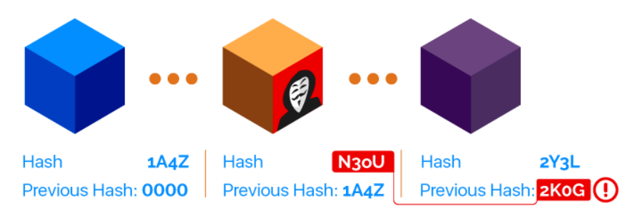
Blockchain Security
Technically, a blockchain is a chain of ordered blocks in a network of untrusted peers. Each block references the previous block and contains data, its own hash and the hash of the previous block.
If anyone changes the data in a single block, the hash of that particular block changes, but it also makes the whole chain invalid.

Slide 8
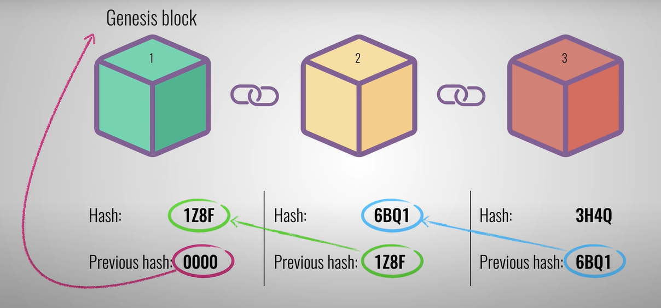
The chain

Slide 9
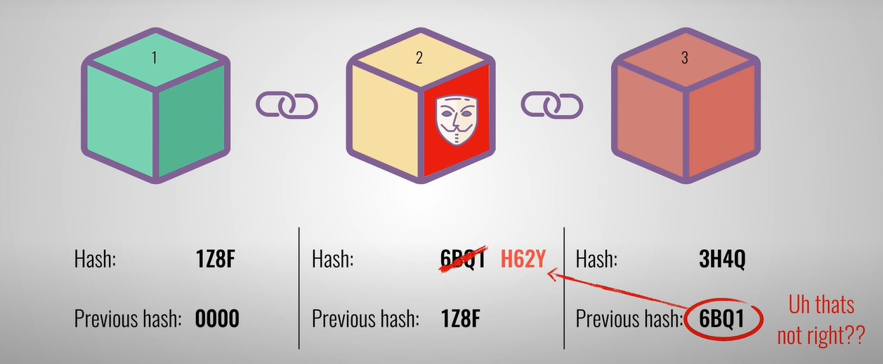
Tampering
How does blockchain avoid someone tampering a block and recalculating the whole chain again?
Using 'Proof of work' to slow down the creation of new blocks.
Using central entity to manage the chain, like the exchanges.
Allowing all people to join the chain and record the previous blocks, the consensus from these people(recorders) is the valid chain.
Using Hash value to link front and back blocks.

Slide 10
Tampering
How does blockchain avoid someone tampering a block and recalculating the whole chain again?
Using 'Proof of work' to slow down the creation of new blocks.
Using central entity to manage the chain, like the exchanges.
Allowing all people to join the chain and record the previous blocks, the consensus from these people(recorders) is the valid chain.
Using Hash value to link front and back blocks.

Slide 11

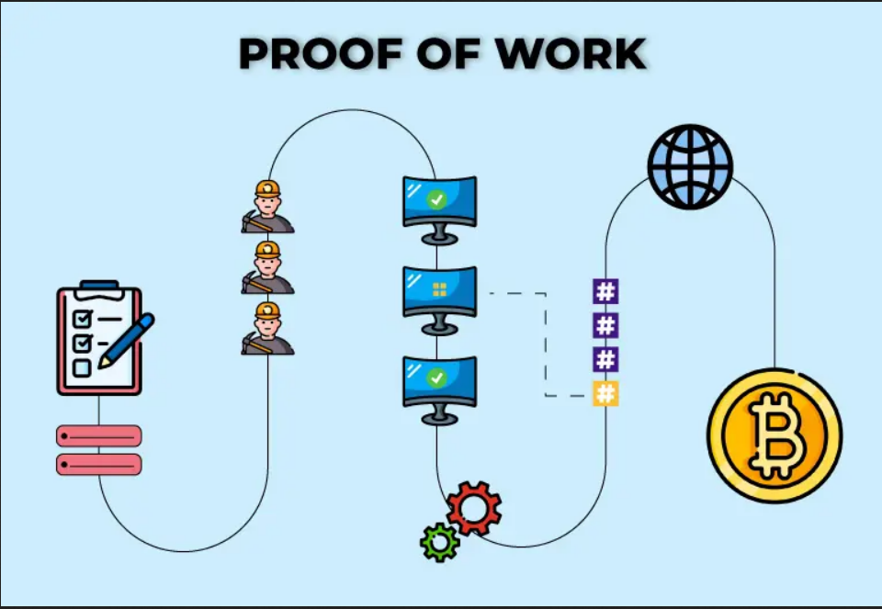
How does blockchain avoid someone tampering a block and recalculating the whole chain again?
Using 'Proof of work' to slow down the creation of new blocks.
Using central entity to manage the chain, like the exchanges.
Allowing all people to join the chain and record the previous blocks, the consensus from these people(recorders) is the valid chain.
Using Hash value to link front and back blocks

Slide 12
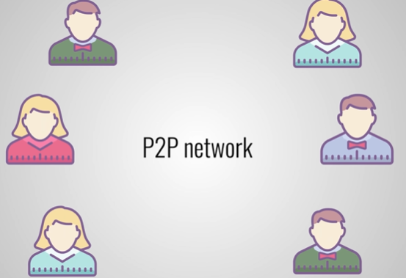
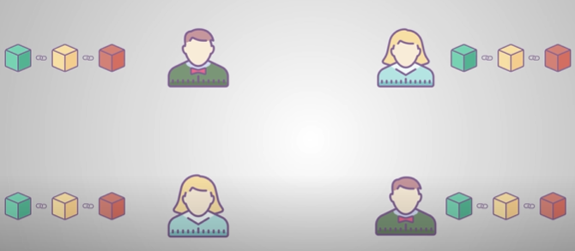

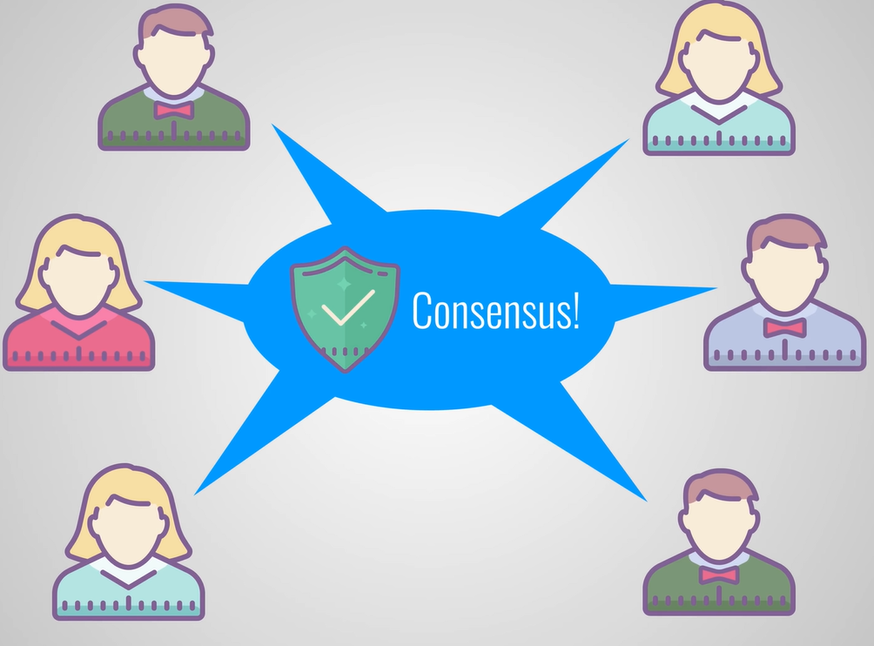
P2P network
Bitcoin - join and receive a full copy of the chain:
An attacker requires more than 50% of the network for the
new block to be accepted.

Slide 13
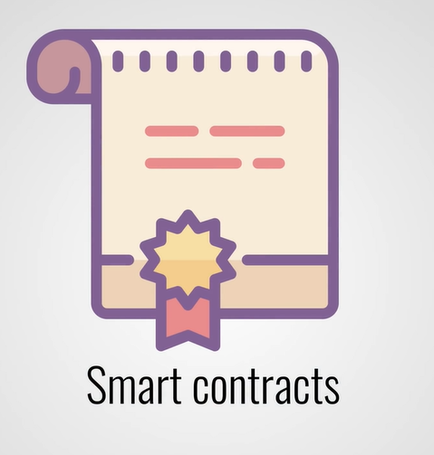
Smart contracts

Slide 14
BLOCKCHAIN
SE SSI O N S 01
Demystifying blockchain and cryptocurrency - Crypto 101
Prof. Manoel Gadi

